Slide 1

Towards Usable Network Traffic Policies for IoT Devices in Consumer Networks
- Garuda Suma Pranavi

Slide 2
Contents
Reasons for vulnerability in home networks
Previous IoT vulnerability exploitations
Related Work
Proposed method
Investigating Traffic Patterns
Access Control Lists and Whitelists
IoT Testbed
Traffic Observations
Inference
Problems
Future Work

Slide 3
The IoT revolution
IoT has changed the way people work, live, travel and entertain themselves.
Ubiquitous connectivity
Cheap, small and powerful devices
Practically unlimited storage and processing power of the cloud
Fitness trackers, Thermostats, IP cameras, smart bulbs, smart watches etc.

Slide 4
Why are home networks vulnerable?
Large variety of devices
Have no network administrator
Little feedback of their activities to users
Cannot run extra software to provide robust security or to detect attacks
Unpatched devices
Notes:
(difficult even for the manufacturer to patch the devices if they leave the factory with a vulnerability).
(limited hardware resources)

Slide 5



Previous IoT vulnerability exploitations
Baby camera search engine
Uses Shodan – ‘scariest search engine’, to easily browse for vulnerable webcams over the Internet.
Notes:
Shodan crawls the internet looking for IP addresses with open ports. If an open port lacks authentication and streams a video feed, it can be accessed by a paid Shodan member.

Slide 6
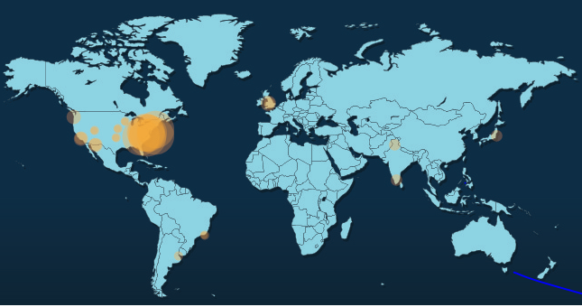
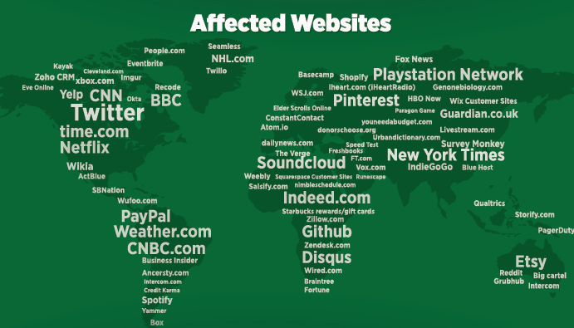
Largest yet seen DDoS attack - Mirai
Enslaved IoT devices such as security cameras, routers, digital video recorders etc. into a botnet.
Attacked Dyn which is a large part of the DNS infrastructure of the Internet.

Slide 7


Smart toys like Dino leaked information about their users or we can inject audio clips into the toy.
Proof of concept attack: a drone can control the smart lights of an entire building by passing by.

Slide 8
Related Work
Samsung SmartThings and Apple Home Kit
Framework to write custom applications.
Standards for transport security and access controls are pre-installed.
Problem: may have overprovisioning of permissions or device specific issues like protocol misuse or exposed debug interfaces.
SVELTE: Focuses on detecting routing attacks in sensor networks
IoT-IDM: Directs IoT traffic to an IDS using OpenFlow controllers.
Notes:
Due to hardware restrictions, traffic analysis should be outsourced to external servers, but this contradicts the security requirements due to the sensitive nature of IoT data as well as latency requirements.

Slide 9
Proposed Method
Home routers - attractive point to observe the device’s interaction with the network as well as to deploy software to detect and potentially mitigate attacks.
New network layer architecture to protect vulnerable IoT devices.
Assuming that IoT traffic is predictable and thus may be feasible to filter using a policy based approach.

Slide 10
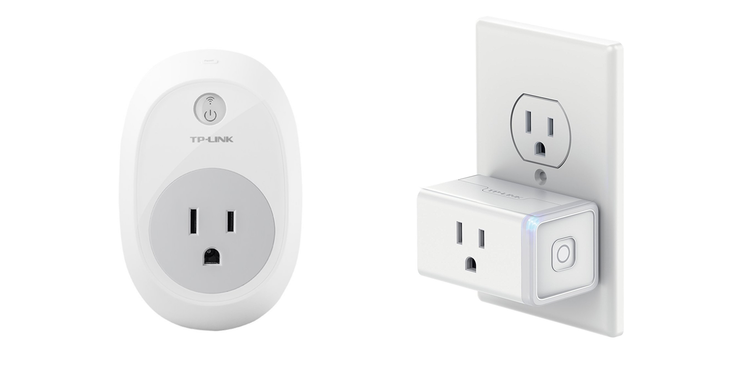
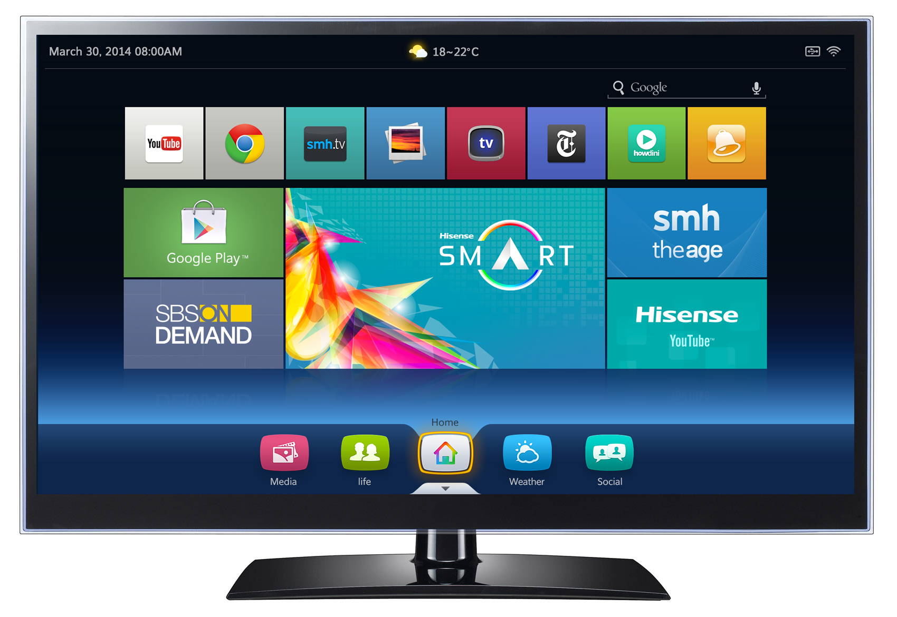
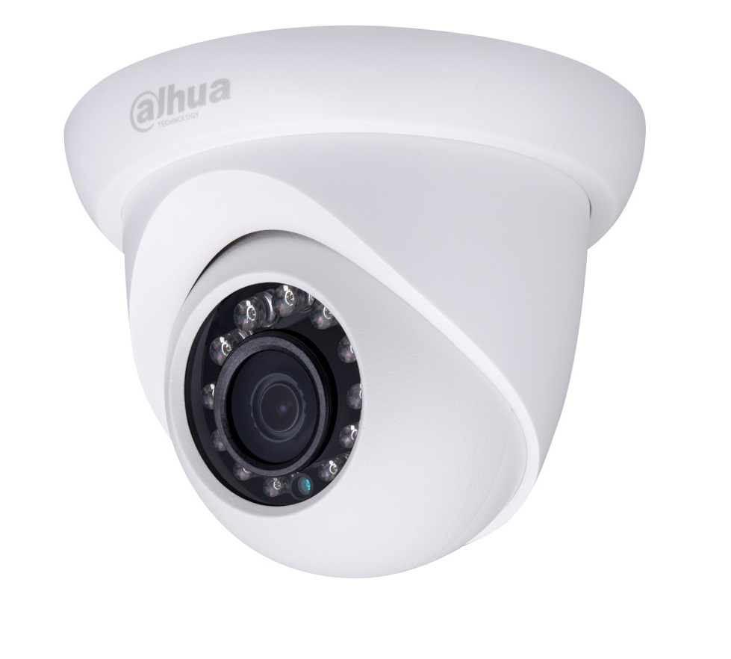
Investigating Traffic Patterns
Security cameras: send video data/motion events/receive requests to record events.
Smart plug: toggling the state/monitoring energy usage.
Smart TV: playing media streams from various content providers.
Notes:
They have a fixed set of functionality unlike a workstation or smartphone, and need to connect to relatively few entities on the internet, mostly remote servers on the cloud.

Slide 11
Since, the set of entities that the devices connect to is limited, it allows construction of lightweight access control policies, or whitelists to restrict communication.
This scheme hence prevents a malicious host from attacking an exposed management interface, or a compromised device or botnet in enforcing a DDoS attack.

Slide 12
Access Control Lists
Destination/Source Address:
Discrete Address
range or subnet
all addresses
Blocking Network protocols/their related ports
IP
TCP
ICMP etc.
Additional flags or identifiers:
Storing information related to a match in a router log
Notes:
Standard ACL’s filtering based on just IP addresses.
Extended ACL can be protocol/ port number or more

Slide 13
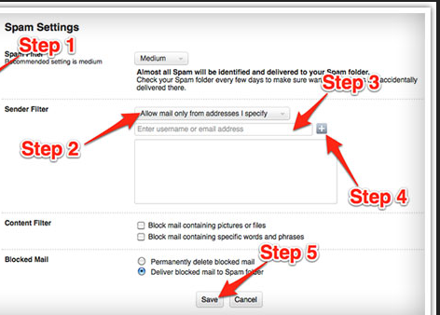
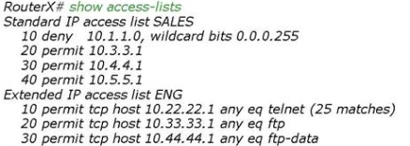
Whitelist
List of items that are granted access to certain systems or protocols.
Notes:
Eg. For remotely managing databases using software on our computer, we need to whitelist our IP on the server.

Slide 14
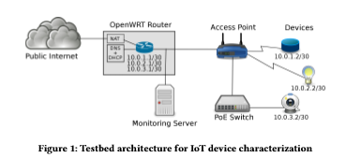
IoT Testbed
TP-Link Router with OpenWRT firmware
Wireless Access Point
(Traffic between access point
and router is mirrored to a
monitoring server)
Power over Ethernet switch for devices like IP cameras (Dahua PoE IP camera)
Amazon Echo Dot
Google Chromecast
TP-Link smart plug
Notes:
Firmware is a computer program that provides low level control for the device’s specific hardware.
OpenWRT is a easily modifiable operating system for your router.
Port mirroring is a method to monitor network traffic. If it is enabled, the switch sends a copy of all the packets hitting one specific port or a VLAN to another port- where the packet can be picked up and analyzed. Another physical machine is connected to this port and a packet monitoring utility is run to sniff the traffic there.
The Chromecast works differently than the Amazon Fire TV, the Roku, and the Apple TV, the other major streaming devices. Those players all have on-screen interfaces that display the channels/apps that can be played through them and they all come with remotes to navigate through the interface. With the Chromecast, you find the content you want to watch/listen to/play on your Android or iOS mobile device or in your Chrome browser and then “cast” it to your TV through the player. (You’re not actually sending the full signal to the Chromecast from your device; you’re just sending the URL and it picks it up directly from the Internet.)
A Power over Ethernet (PoE) switch is a dedicated device that contains multiple Ethernet ports to provide power and network communications to IP cameras.

Slide 15
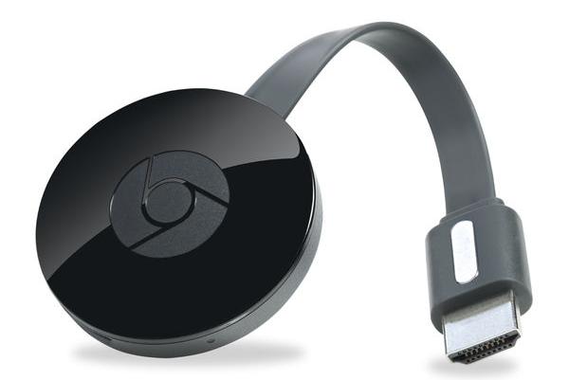
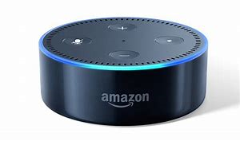

Slide 16
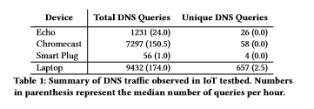
Traffic Observations
Identifying patterns in the DNS queries and the IP addresses.
Notes:
Like the chromecast made 7297 total DNS queries, but to only 58 unique domain names and most of them were notice to be in the Google service domains.

Slide 17
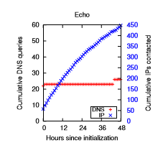
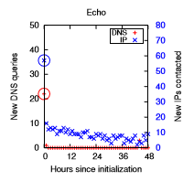
DNS queries and IP addresses contacted:

Slide 18
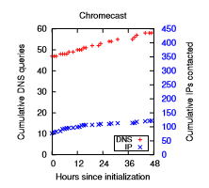
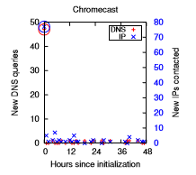
DNS queries and IP addresses contacted:

Slide 19
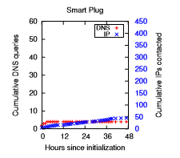
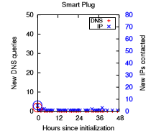
DNS queries and IP addresses contacted:

Slide 20
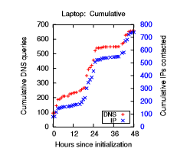
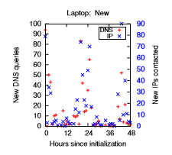
DNS queries and IP addresses contacted:

Slide 21
Inference from data
After initialization, each device performed minimal new DNS queries indicating that the devices are making queries for the same domain names. This is in comparison to the 30 new domains per hour on a laptop or smartphone.
This supports hypothesis for building whitelist-based policies to account for common case traffic.

Slide 22
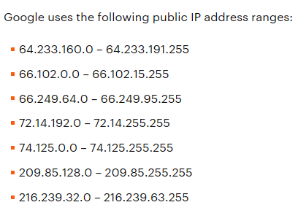
The devices contact a larger range of IP addresses than DNS names, since the IP address associated with a DNS name may change over time due to load balancing. Thus we can’t use simple IP or AS number matching.
Notes:
An anonymous open proxy allows users to conceal their IP address while browsing the Web or using other Internet services.

Slide 23
Echo and Chromecast contacted a number of new IP’s but they were localized to Amazon’s or Google’s networks.
The smart plug’s unique IP addresses come from queries to public NTP pools – wide array of IP ranges and subnets.
Notes:
Smart plug first connects to the public NTP pool, most probably for time configuration and then connects to tplinkcloud on AWS for a security certificate. It is then controlled via an app on the phone, which keeps polling the plug at regular 2 second interval. Connects to the plug via TCP over port 9999 and exchanges a 55 byte payload.

Slide 24
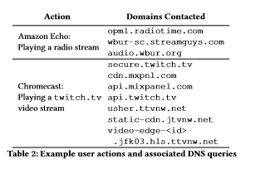
Problems:
These devices are loading content from entities other than their main cloud provider, which creates additional challenges for building policies.
Notes:
Some legitimate device actions, such as playing third party audio or video streams from Chromecast/Echo initiate connections to entities not used during normal operations.

Slide 25
Future Work
Dynamic device policies through SDN
Dynamic device policies through a capability based framework
Explicitly infecting devices with malware to compare traffic patterns in compromised devices.
Using DNS Sec
Local processing capabilities for privacy, efficiency and reducing latency.
Study of how we are installing the repositories for a specific device using the installation process.
Machine learning techniques for anomaly detection among home routers on the cloud.

